Slide 1
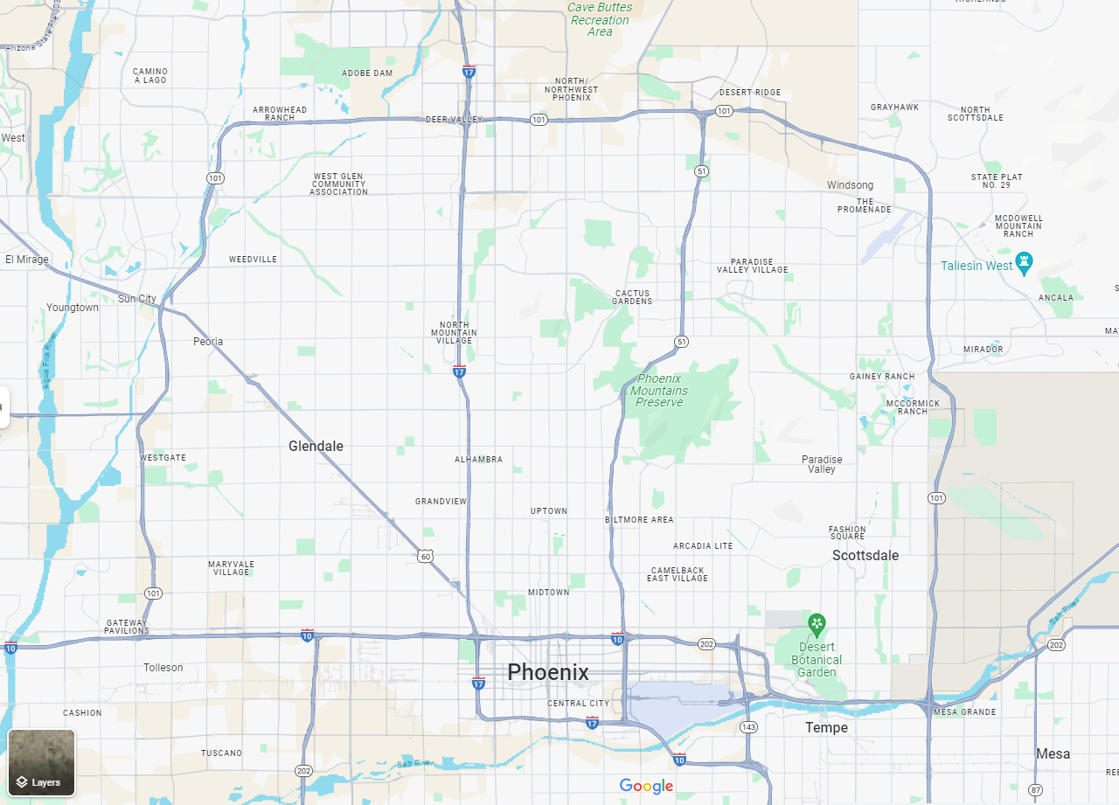
SITE ELEMENTS LIFE SAFETY SERIES
ORB University
ORB UNIVERSITY – July 10th, 2024 PRESENTED BY JHON HEREDIA
Notes:
Use this to guide you on what you will say. Don’t put text in the slides. Just read it from here.

Slide 2
Content:
Development data.
Applicable codes per municipality.
Fire apparatus access roads.
Fire Hydrant distances.
Fire Department Connections.
Building Aerial Access.
10’-1” minimum setback from property line.
Percentage of openings and rated parapet.

Slide 3
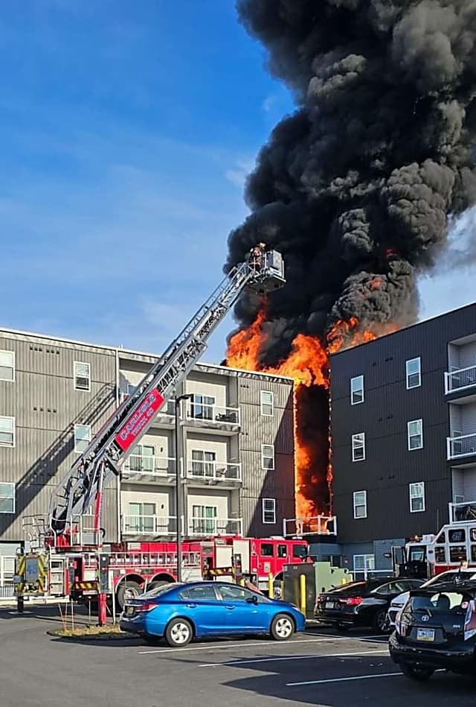
What is life safety about?
We need to be conscious that we are talking about the preservation of life in case of fire or in an emergency.
It is important to follow:
IBC applicable codes.
Municipal code amendments.
Fire department guidelines.
IFC International Fire Code.

Slide 4
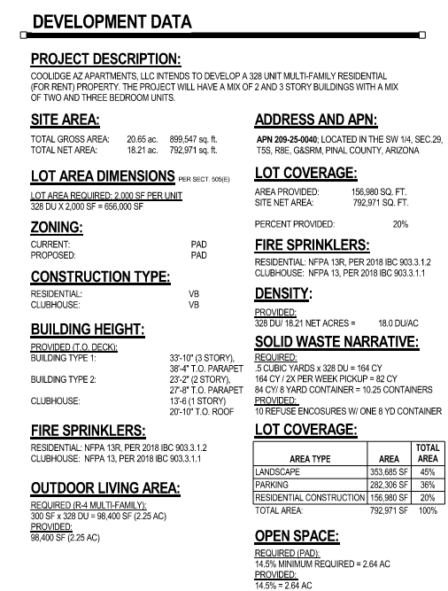
What is the minimal information required for the fire reviewer?
Fire Sprinkler/ Alarm:
Specify the types of fire sprinkler system to be used according to the building use.
Construction Type:
Specify the construction type will be proposed per building use.
Building height:
Specify the allowed height per the municipality zoning development standards and the building code. Specify proposed building height number of stories.
NOTE: Request a “Fire flow test” NFPA will require a minimum water pressure if not met will need a booster pump.

Slide 5
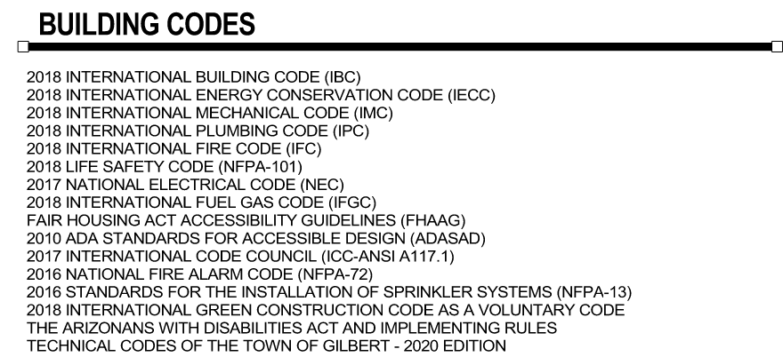
Applicable codes per municipality.
City of Phoenix:
https://www.phoenix.gov/pdd/devcode/buildingcode
City of Scottsdale:
https://www.scottsdaleaz.gov/codes-and-ordinances
City of Tempe:
https://www.tempe.gov/government/community-development/building-safety/building-codes-and-amendments
Town of Gilbert:
https://www.gilbertaz.gov/departments/development-services/plan-review-inspection
City of Glendale:
https://www.glendaleaz.com/work/building_codes___services/building_codes
City of Chandler:
https://www.chandleraz.gov/government/departments/development-services/building-safety-plan-review-permits-and-inspections
City of Tucson:
https://www.tucsonaz.gov/Departments/Planning-Development-Services/Codes/Building-Codes

Slide 6
Fire apparatus access roads

Slide 7
Fire apparatus access roads

Slide 8
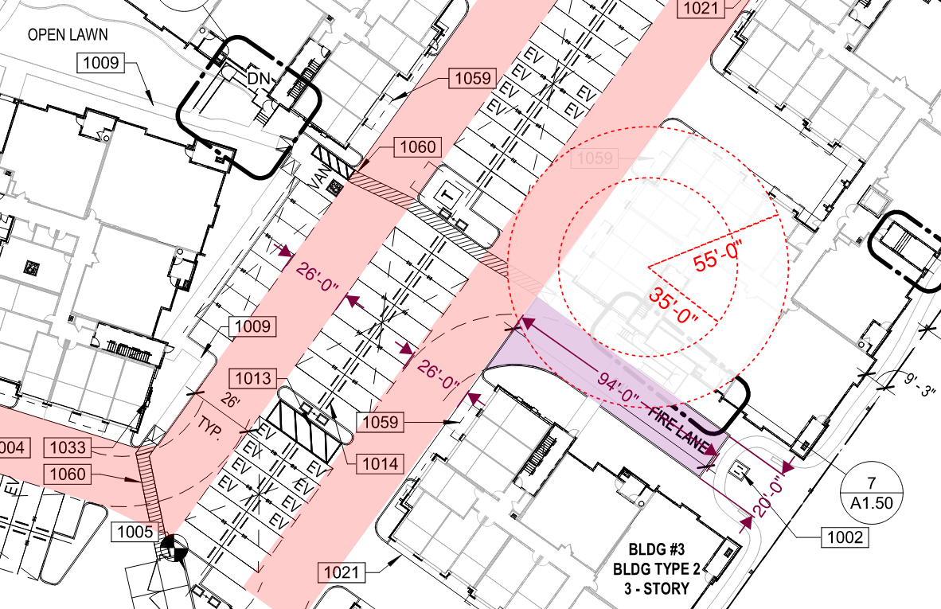
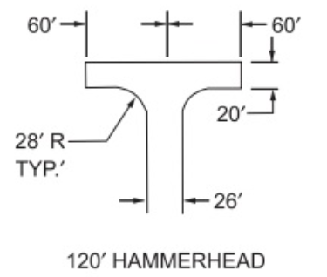
City of Phoenix Planning & Development Department Parking Requirements Guidelines – Page 6 of 12
503.2.4 Turning radius
503.2.1 Dimensions, 503.2.3 Surface, 503.2.3.2 Live Loads, 503.2.5 Dead ends, 503.2.9 Curbs
IFC 2018 - D103 Minimum specifications

Slide 9
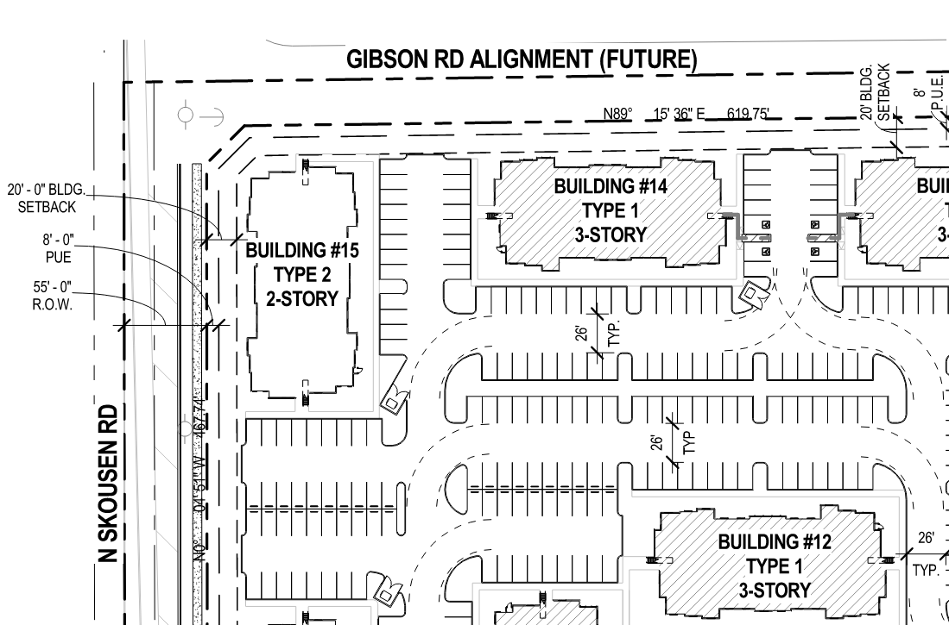
Fire apparatus access roads

Slide 10
Appendix D Fire Apparatus Access Roads
Building Aerial Access

Slide 11
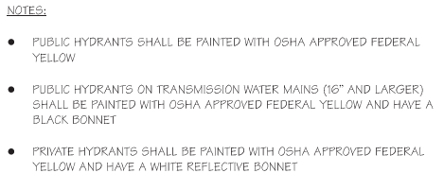
Fire Hydrant
How to recognize them in the field?

Slide 12
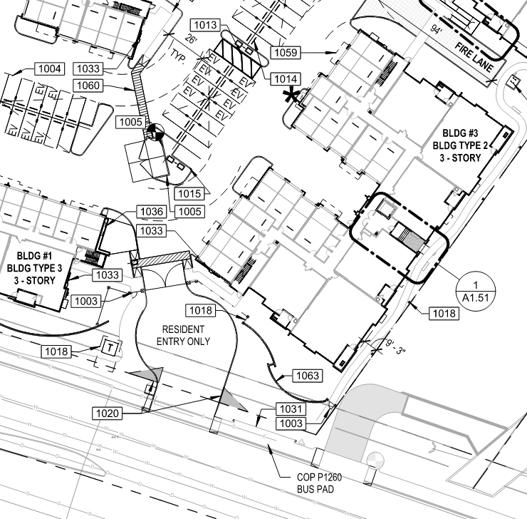
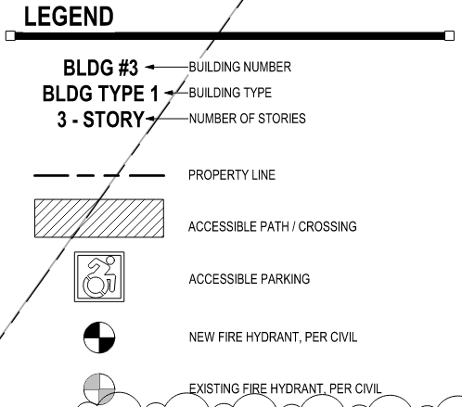
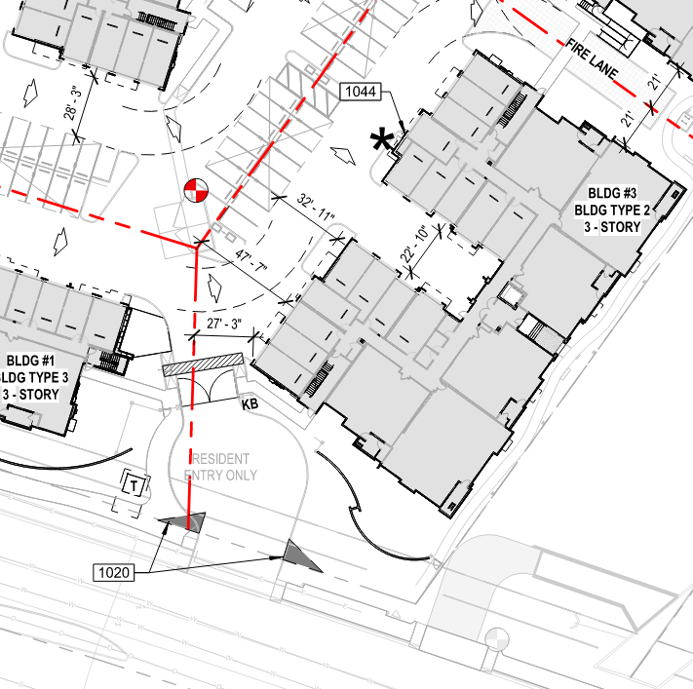
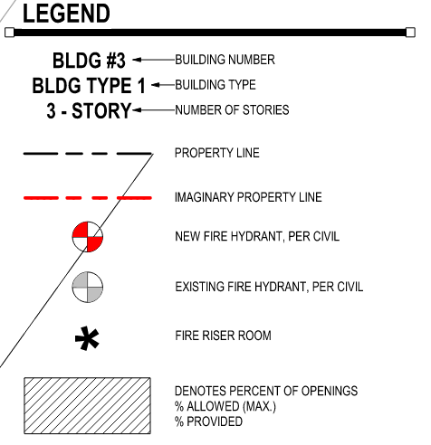
Fire Hydrant
How we show them?
A1.10 Site plan
A1.12 Fire separation plan

Slide 13
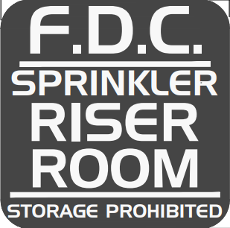
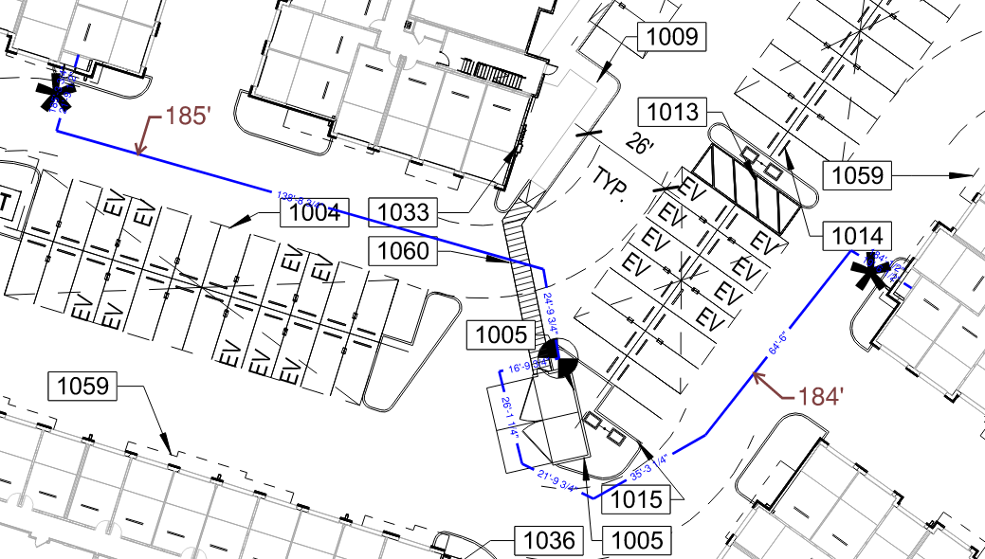
Fire Department Connection
Distance from Fire Hydrant to FDC
507.5.1.2.7 Additional hydrants shall be spaced approximately 300 feet apart in all other developments.
NOTE: Fire hydrants are under the civil engineer's scope. Civil engineer will place and verify distances between fire hydrants, fire department connections and fire risers to the outside of the building.

Slide 14
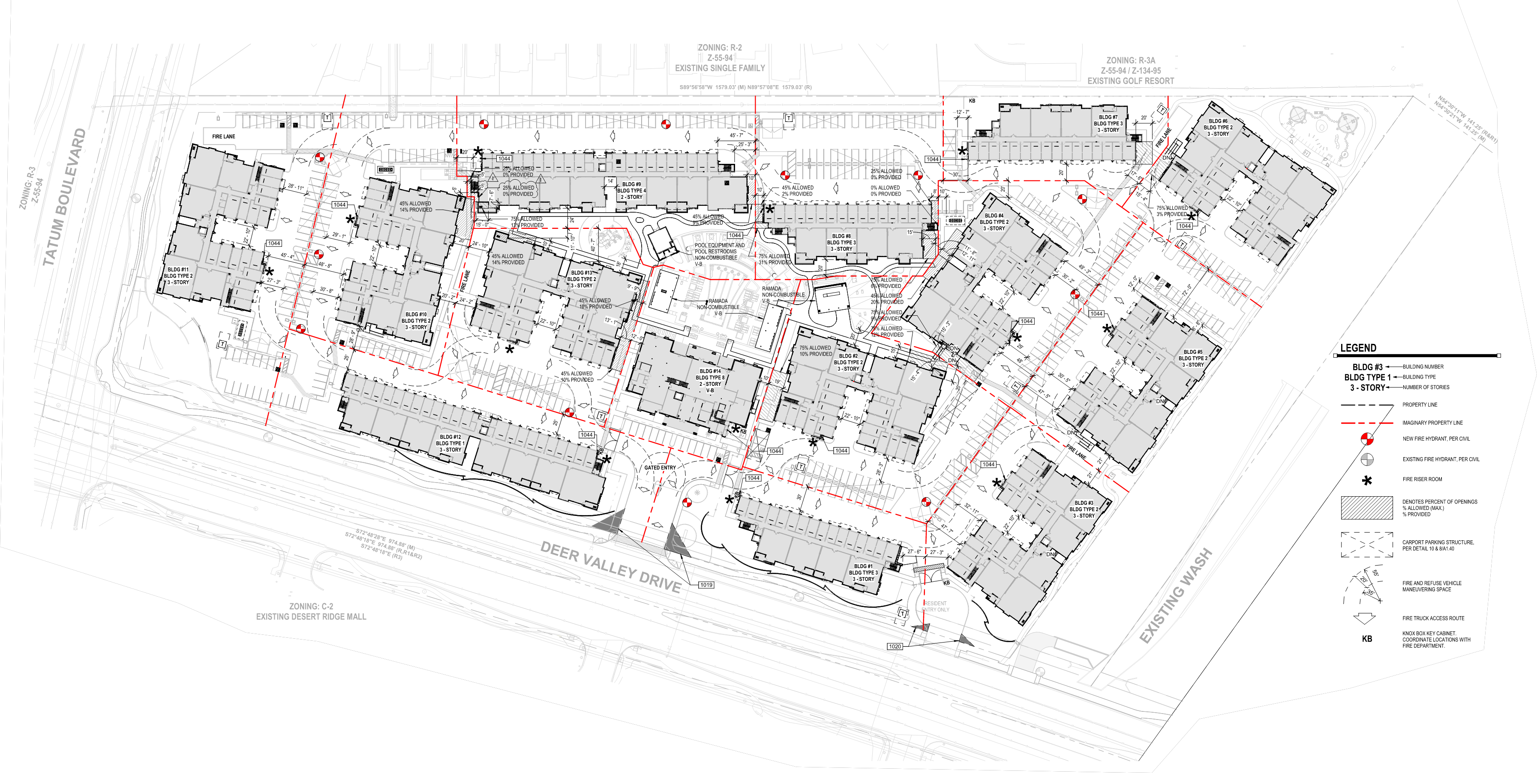
Percentage of openings and 25% of opening or rated parapet.

Slide 15
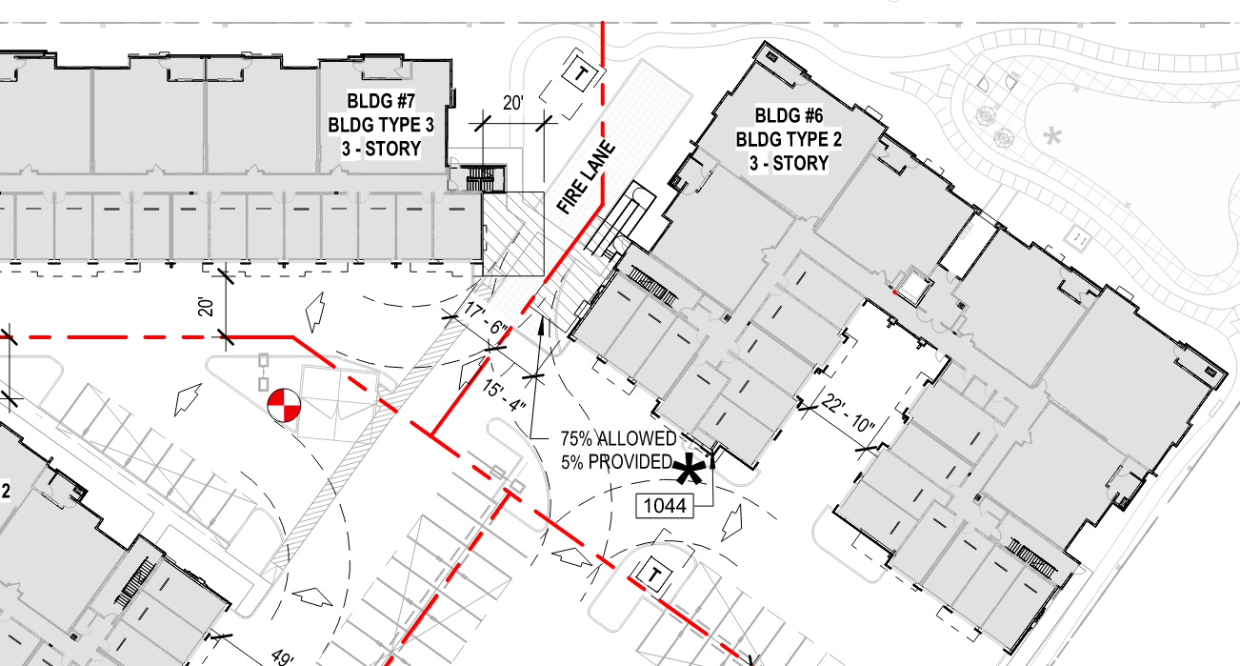
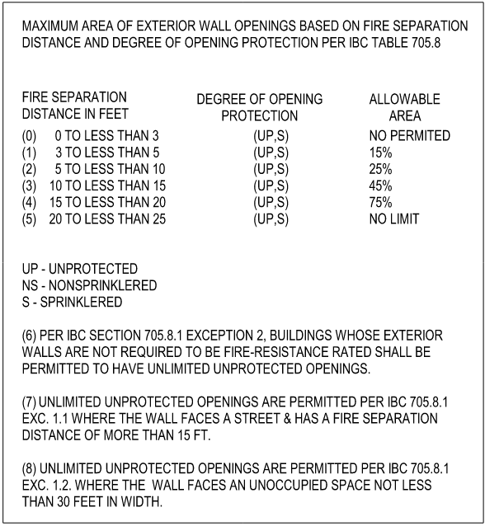
Percentage of openings and 25% of opening or rated parapet.

Slide 16
How to calculate the % of opening?

Slide 17
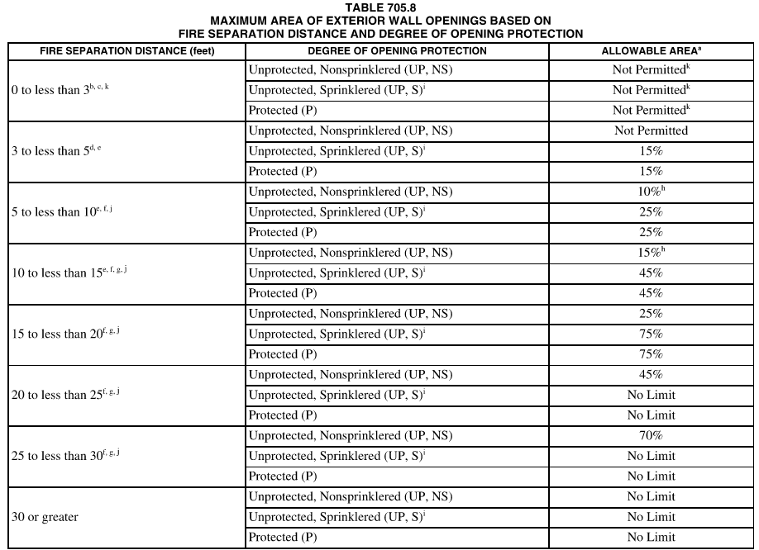
IBC 2018 - 705.11 Parapets
705.11 Parapets. Parapets shall be provided on exterior
walls of buildings.
Exceptions: A parapet need not be provided on an exterior wall where any of the following conditions exist:
1.The wall is not required to be fire-resistance rated in accordance with Table 602 because of fire separation distance.
2.The building has an area of not more than 1,000 square feet (93 m2) on any floor.
6. Where the wall is permitted to have not less than 25 percent of the exterior wall areas containing unprotected openings based on fire separation distance as determined in accordance with Section 705.8.
NFPA 13
NFPA 13R

Slide 18
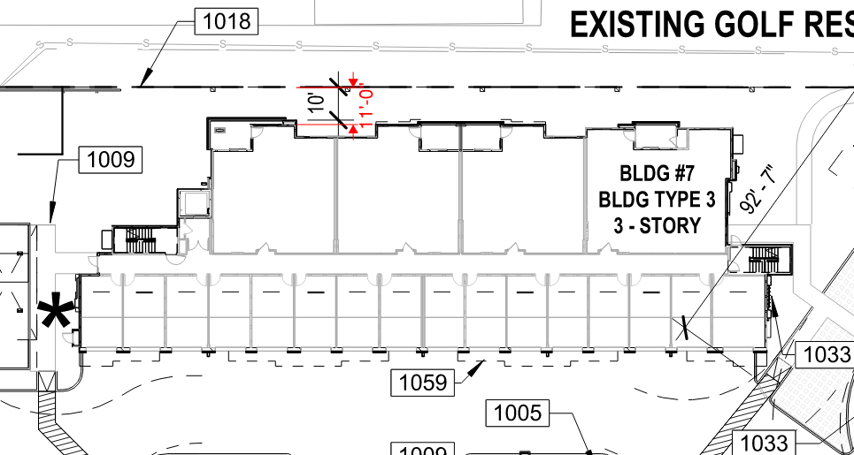
10’-1” minimum setback from property line.
705.5 Fire-resistance ratings. Exterior walls shall be fire-resistance rated in accordance with Tables 601 and 602 and this section. The required fire-resistance rating of exterior walls with a fire separation distance of greater than 10 feet (3048 mm) shall be rated for exposure to fire from the inside. The required fire-resistance rating of exterior walls with a fire separation distance of less than or equal to 10 feet (3048 mm) shall be rated for exposure to fire from both sides.

Slide 19
Site Exercise
Place imaginary property line.
Place new fire hydrant.
Place fire department connection symbols across the site.
Identify the fire lane.
Locate one aerial access that complies with the 15’-30’ criteria.
Locate where the percentage of openings will be need it.
Provide critical dimensions on site plan.

